Slide 1



On-Demand
Services
Presented By:
Vrunda Parmar
Ishita Pokar
Anytime Anywhere
Services Simplified
www.ondemand.com

Slide 2




Introduction
The “On-Demand Services” is an web application.
We will be make node.js and react.js using MYSQL database.
This project is a full-stack web application that connects users with verified professional service providers. It helps users book daily essential services like cleaning, repairs, and deliveries with just one click.
The platform focuses on speed, security, and reliability, offering features such as easy booking, service scheduling, user login, reviews, and secure payments. It simplifies the service process for customers while helping service providers reach more users through a single digital platform.

Slide 3

Aim Of The Project
The aim of this project is to develop a secure and user-friendly on-demand service platform that allows users to easily book daily home and professional services while connecting them with reliable and verified service providers, ensuring convenience, efficiency, and customer satisfaction.

Slide 4

Tools And Technologies
Front End
Back End
Database
Documentation Tools
Development & Testing
HTML
CSS
JAVASCRIPT
J QUERY
BOOSTSTRAP
REACT.JS
NODE.js(EXPRESS JS)
MY SQL
MS WORD
POWER POINT
DRAW.IO
VISUAL STUDIO CODE

Slide 5


Modules & Sub Module
1
Admin Module
Manage users and service providers
Approve and verify service providers
2
User Module
User Registration & Login (Email/Phone Authentication)
Profile Management
3
Service Provider Module
View and Respond to Booking Requests

Slide 6

Admin Module Diagram
Manage Services
Manage Pack
Home
Book Service
Log In
Manage Payment Process
Log Out

Slide 7
User Module Diagram
Services
Book Service
Sign In
Payment Process
Sign Out
Add pack

Slide 8
Thank You

Slide 9

Lifestyle Impact
We understand that cleaning is part of daily life, but it should not feel like a burden. That is why our products are designed to fit into routines naturally, offering an effortless experience that not only improves cleanliness but also aligns with the aesthetic values of a modern minimalist household.

Slide 10


Young professionals living in urban apartments.
Target Market
Minimalist homeowners who value design and simplicity.
Hospitality businesses emphasizing modern interiors.

Slide 11
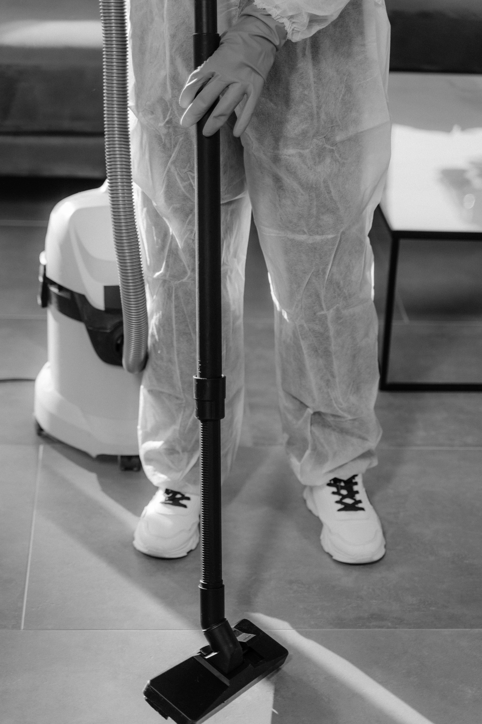
Sustainable Approach
Our tools are designed with sustainability in mind, using recyclable materials and eco-friendly production methods. Every product reflects a balance between performance and environmental responsibility, making them an ideal choice for customers who value conscious living.

Slide 12

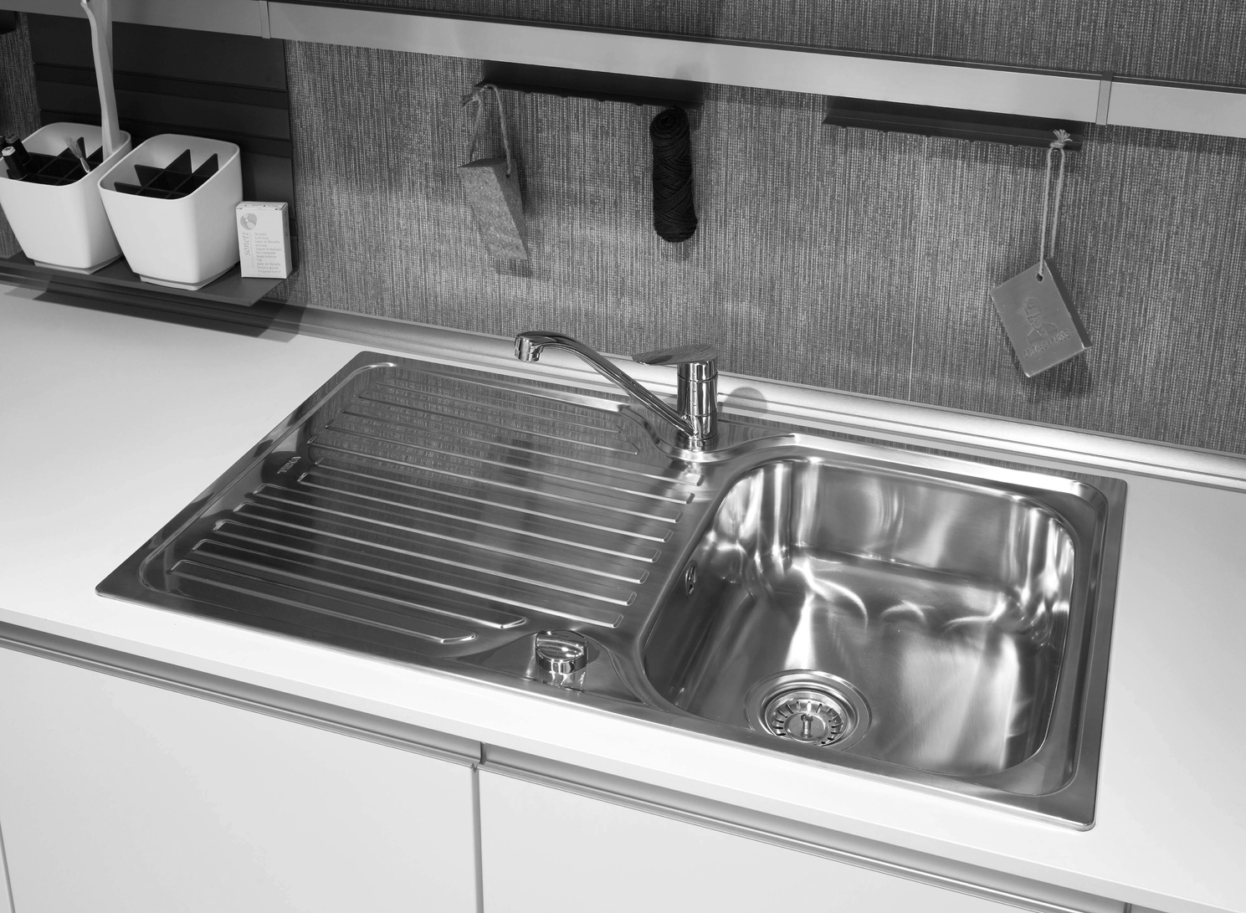
Everyday Applications
Stylish tools that can be displayed without clutter.
Compact storage for small apartments and homes.
Efficient cleaning without unnecessary complexity.

Slide 13

Closing Statement
Ingoude Company delivers more than cleaning tools, we provide modern minimalist solutions that redefine how homes are kept clean and organized. With our products, customers can embrace efficiency, sustainability, and elegance, turning the act of cleaning into a seamless part of a refined lifestyle.

